Slide 1
Preparing for Career…
Yogesh Kulkarni

Slide 2
What’s coming?

Slide 3
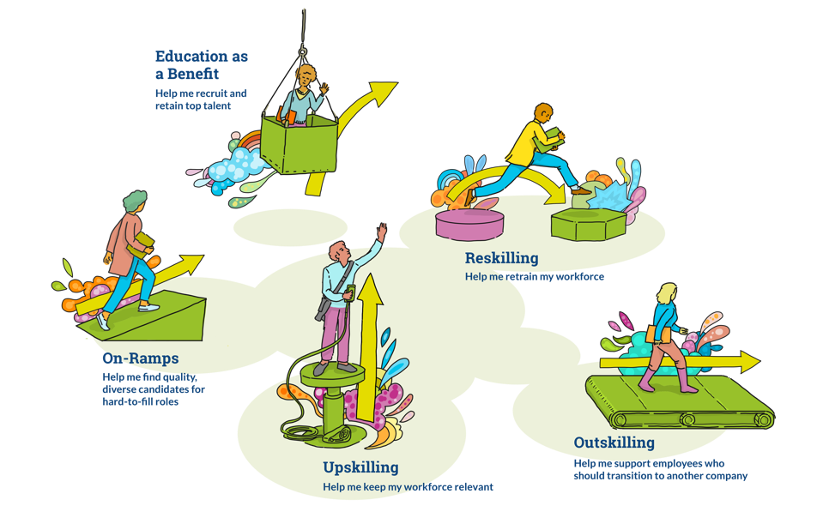
Current State
44% of US workforce < $18K/yr (< poverty line), works 80-100 hrs/week
Automation CAGR 7% (as per BCG), to reach $114B by 2025
Source: As Pressure To Upskill Grows, 5 Models Emerge – Forbs.com

Slide 4
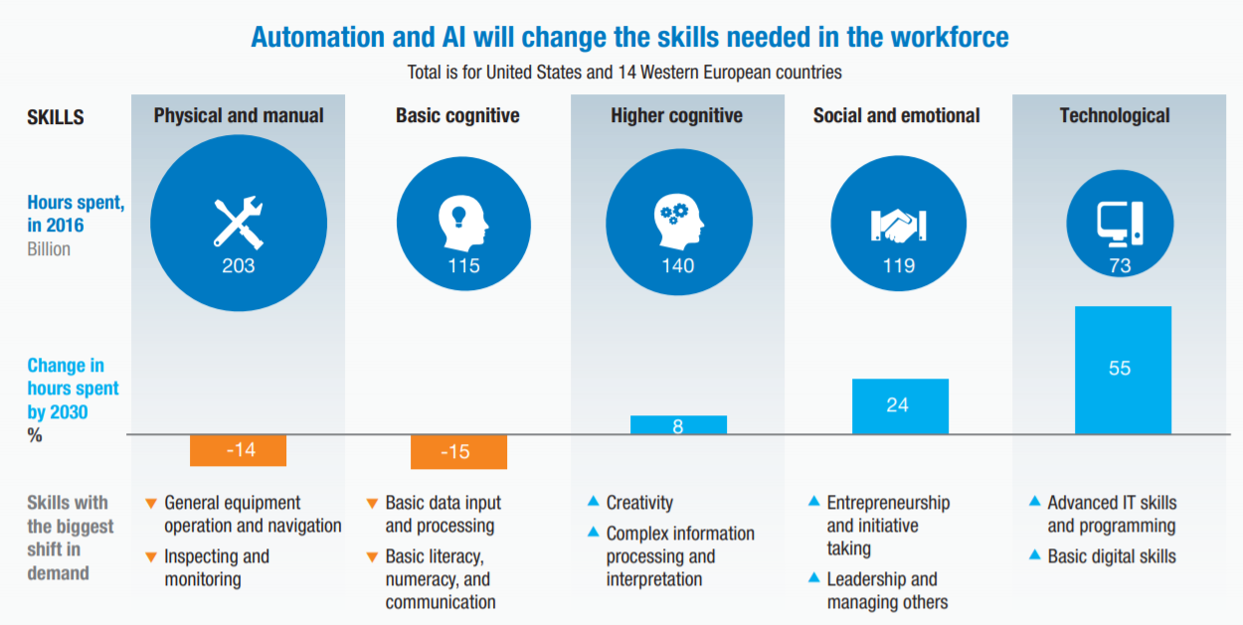
McKinsey Global Institute Report – Discussion Paper 2018

Slide 5
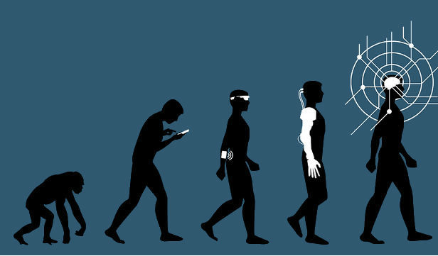
Examples
More Cognitive, Creative, Human
Software developers
Customer service representatives
General and operations managers
Human resources managers
Personal finance advisors
Psychologists
Artists
Sportsman
Researchers
Nurses, care
Less mechanical, automatable
Bill and account collectors
Data entry operators
Computer network support
Secretaries and administrative assistants
Insurance sales agents
Office clerks
Source: The Simplistic Debate Over Artificial Intelligence – Preston Estep

Slide 6
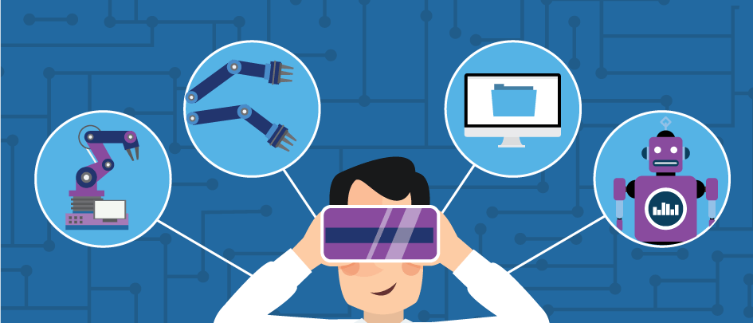
Changes
Technological
AI deluge
Digitization -> Data + APIs
Remote *
Source: Rise of the Chatbots: How AI Changed Customer Service – Salesforce.com
Social
Over interaction + isolation
Obsolete roles, emergence of new
Lifelong re-skilling
Financial
Widening gap
Flatter world
Gigs over jobs

Slide 7
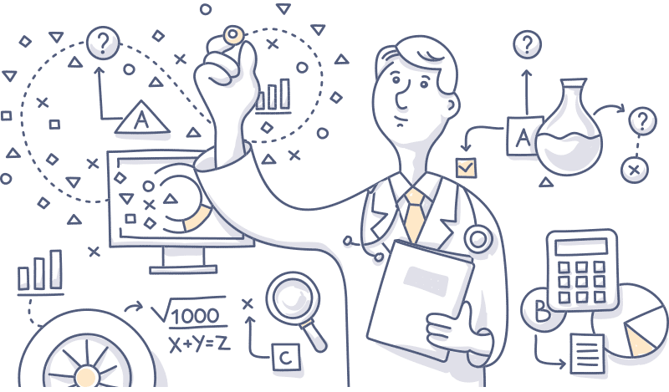
Examples
Technological
Medical: diagnostics, drug discovery, pharmaco-vigilance
Digitization -> Legal, Health records,
Jan Dhan-Aadhaar-Mobile Trinity
Social
e Governance, e Education, wider reach
Push due to COVID
No geo-restrictions for teachers, IT workers, lawyers…
Source: AI in healthcare – foreseemed.com

Slide 8
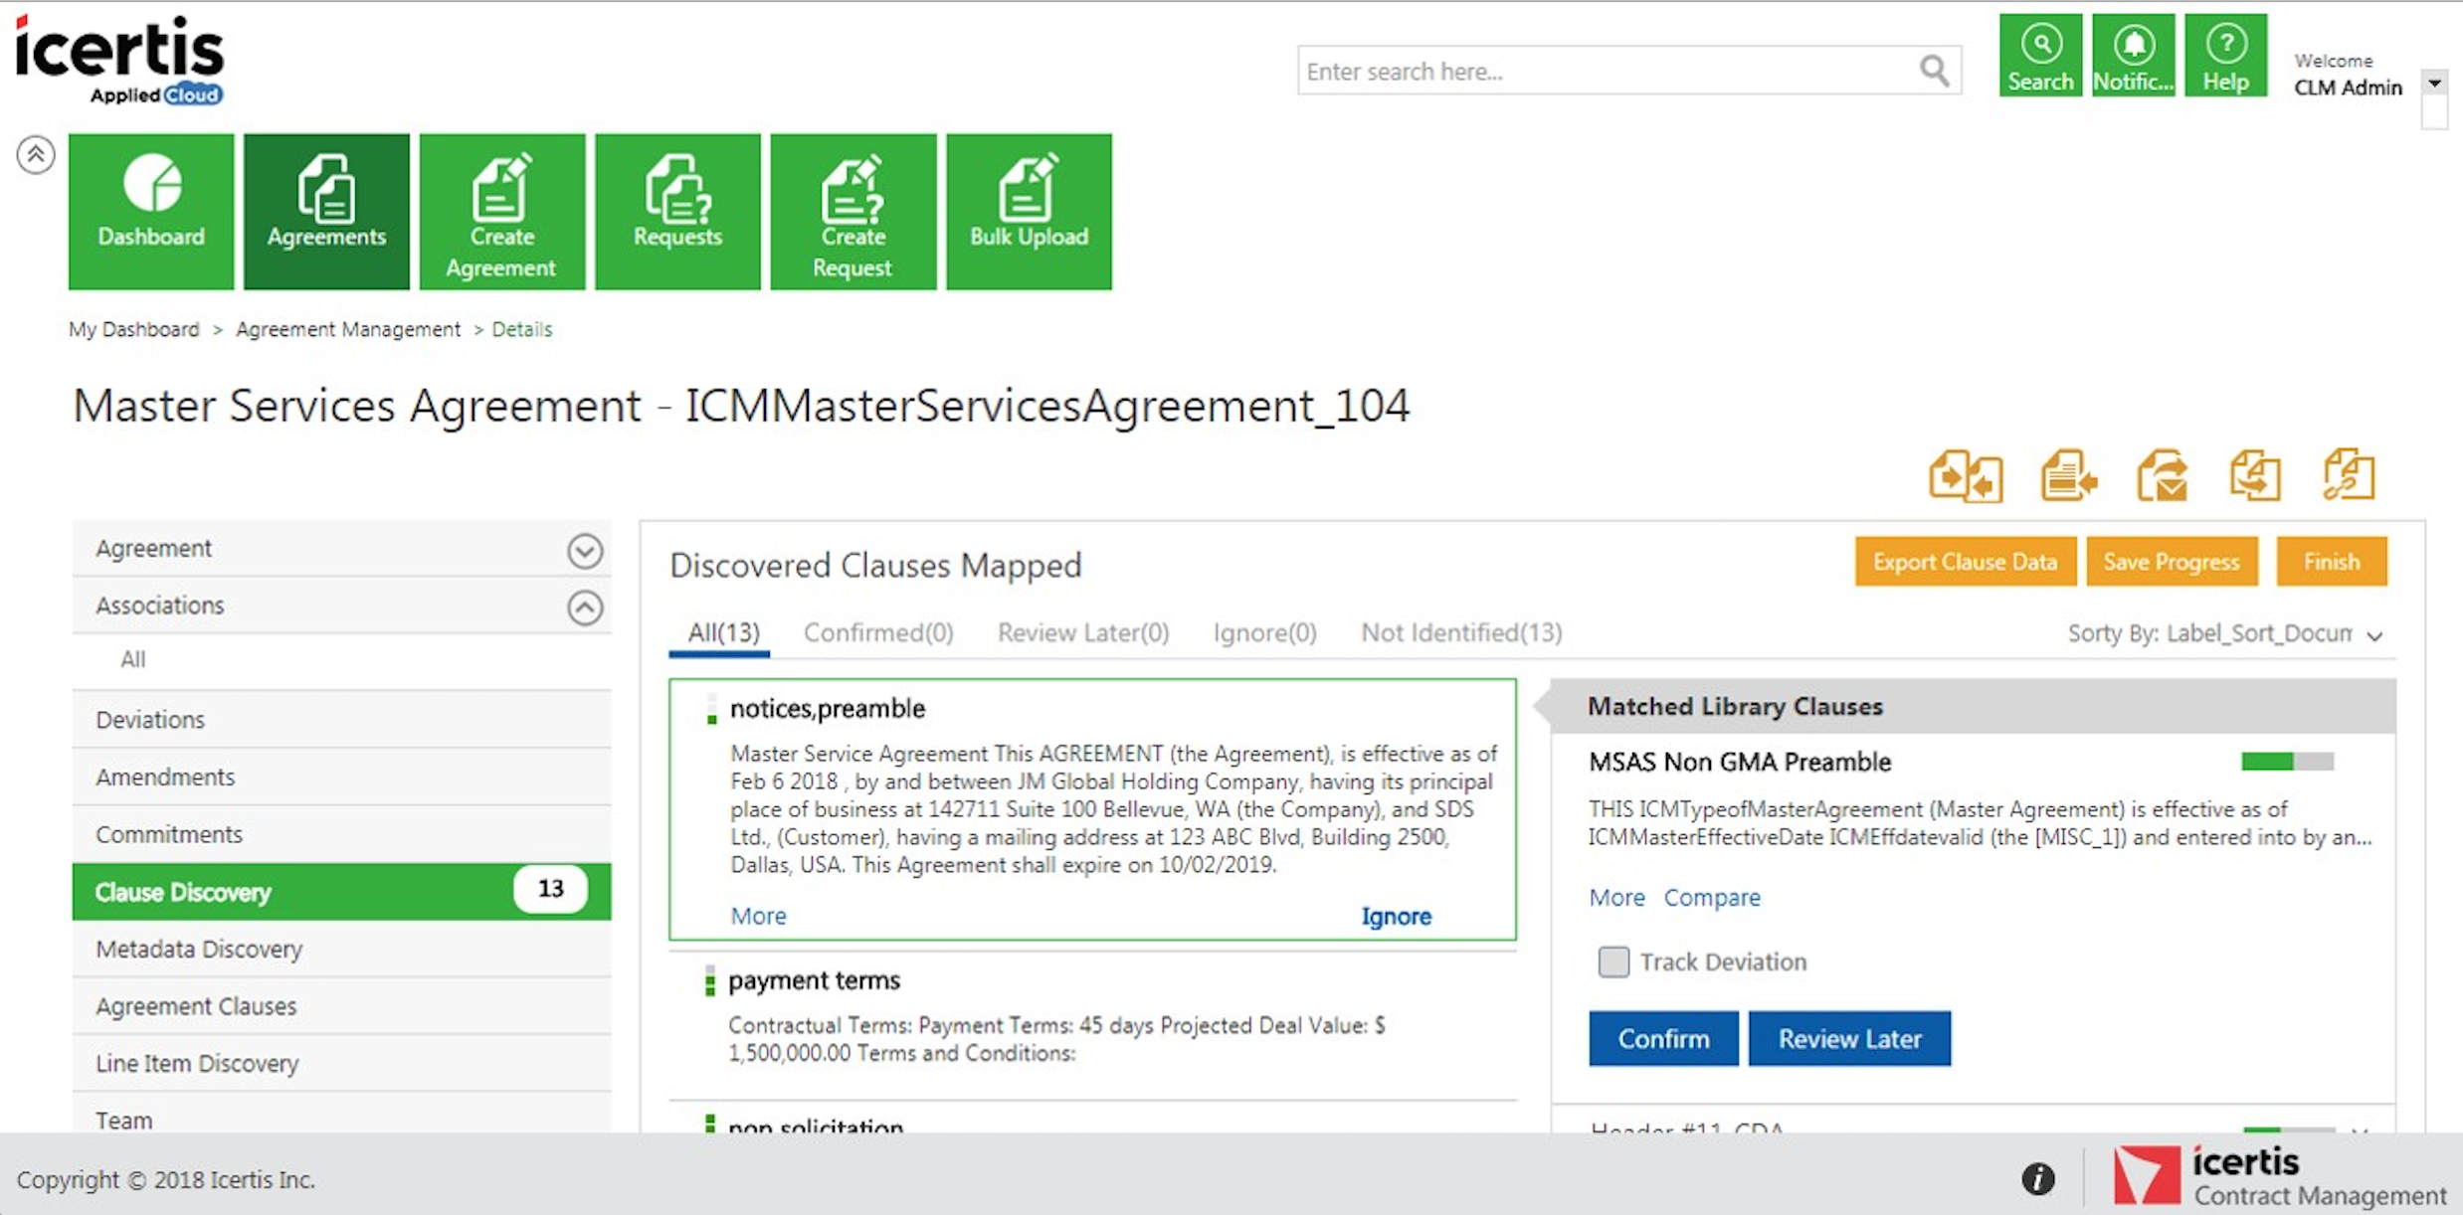
Examples

Slide 9
What got you here, won’t get you there!! - Marshal Goldsmith

Slide 10
How to prepare?

Slide 11
Well, you can’t prepare!! specifically…

Slide 12
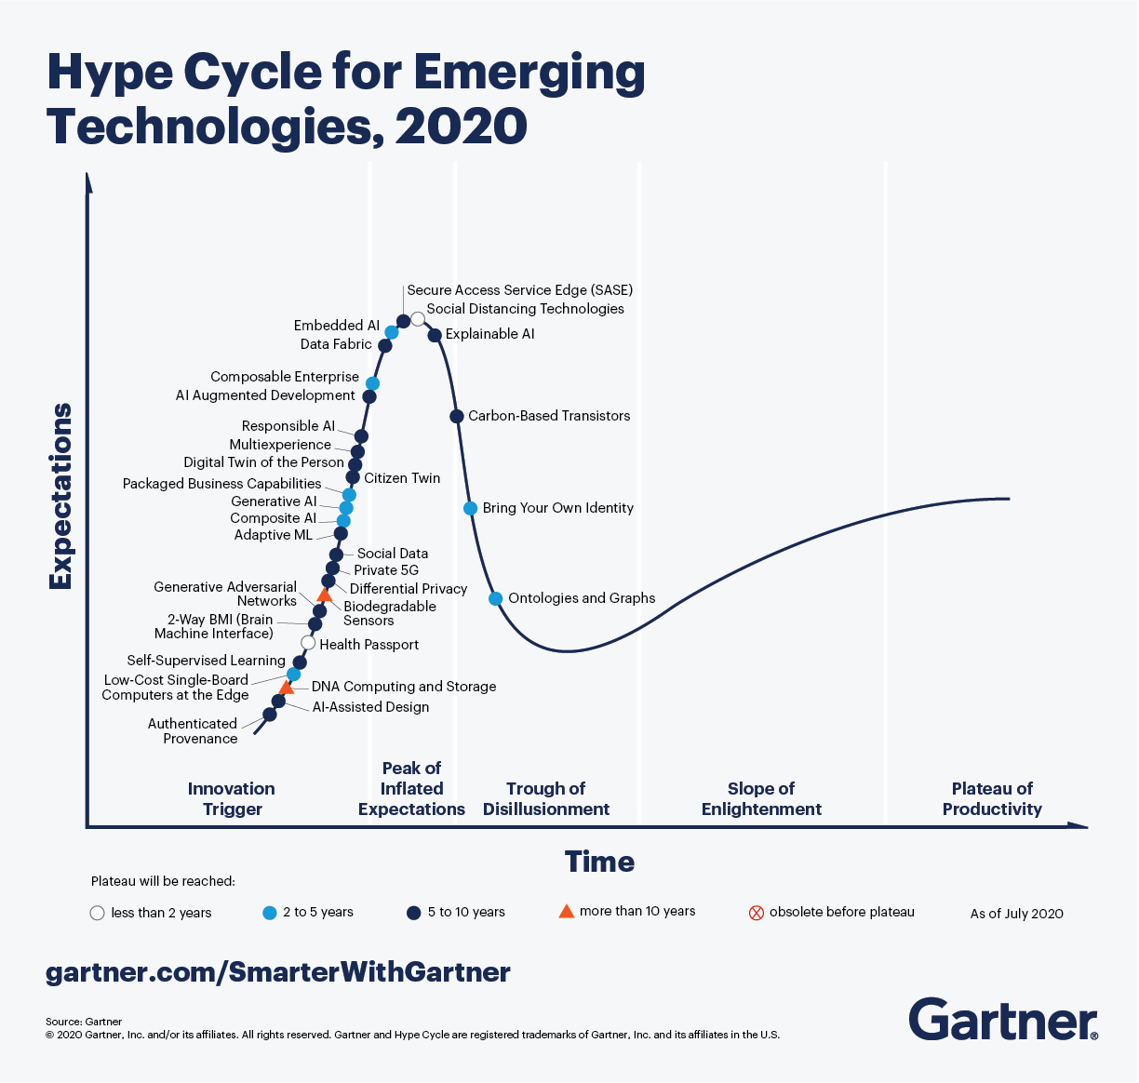
Upwinds

Slide 13
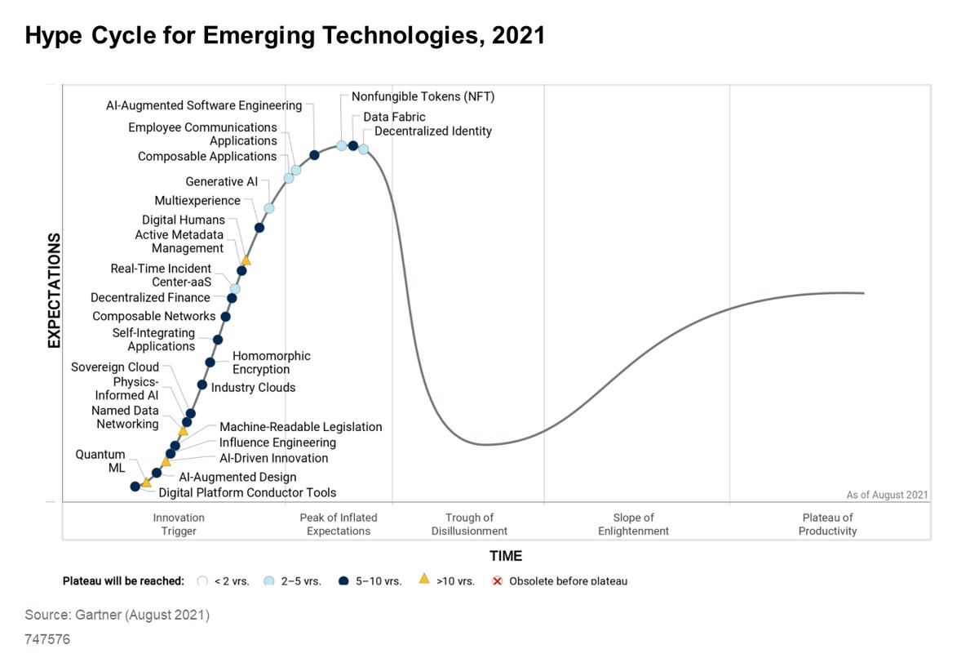

Slide 14
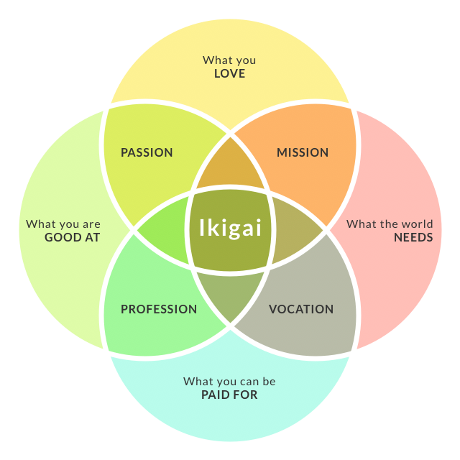
Ikigai
Source: How To Find Your Ikigai And Transform Your Outlook On Life And Business - Chris Myers

Slide 15

Generic Gyan
Specific Knowledge
Unique, rare combination
Un-trainable, un-scalable
Acquired thru apprenticeship
Leverage:
Permissioned: Capital, Labor
Un-permissioned: Content, code
Marginal cost of duplication
Own story:
Current jobs were not available 10 yrs back
Pick difficult problems/domain, Job, RnD
If not now, can change later, Mid career change, harder, but possible.
Wealth is a positive sum game

Slide 16
Thank You
yogeshkulkarni@yahoo.com

